Slide 1
Areeba Ali Presentation Of ICT Topic:Thermal Paste

Slide 2
Thermal paste\THERMAL COMPOUND\THERMAL GREASE: what is thermal paste:
It is a substance applied between the heat-producing component (like a CPU or GPU) and a heat sink to improve thermal conductivity.

Slide 3
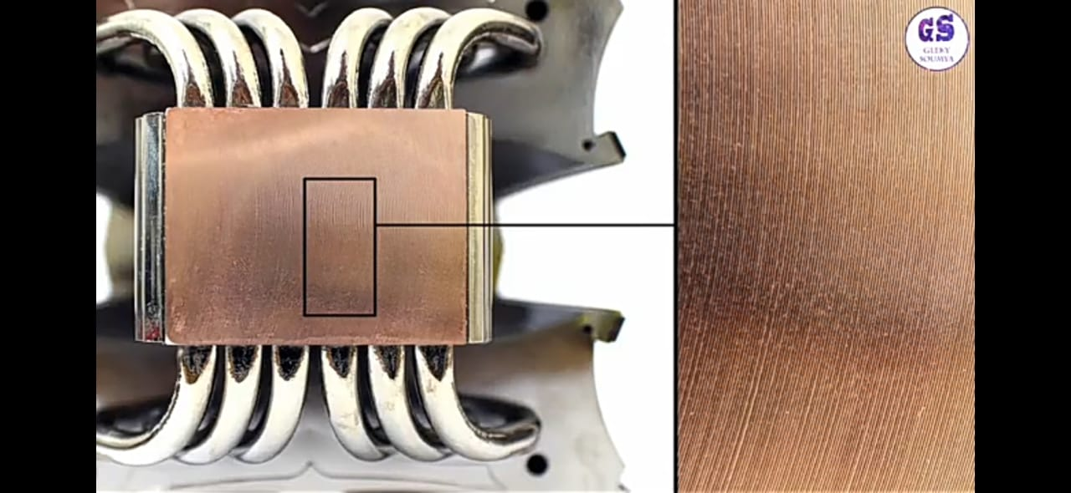

WHY TO USE:
Its primary function is to enhance thermal conductivity, improving the transfer of heat away from the component to prevent overheating and ensure optimal performance.

Slide 4
Where to use:
Primarily used in computers and electronics to facilitate heat transfer between processors and heat sinks.

Slide 5
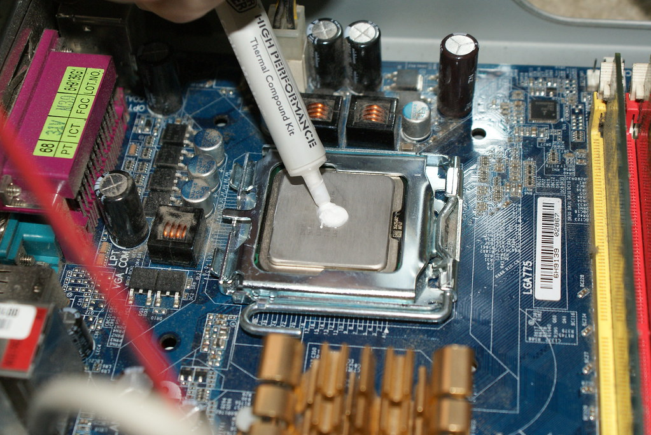
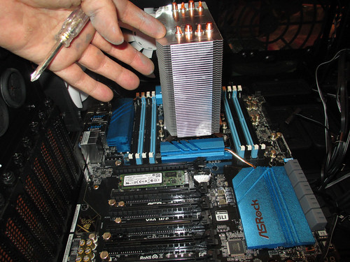
Thermal paste:
This Photo by Unknown Author is licensed under CC BY-SA-NC
This Photo by Unknown Author is licensed under CC BY-NC-ND

Slide 6
HOW TO USE:
1.Clean the Surface: Ensure both surfaces are clean with isopropyl alcohol and a lint-free cloth before applying new thermal paste.
2.Apply Paste: Place a small amount (about the size of a pea) in the center of the component.
3. Spread (if needed) : Some prefer to spread it evenly, while others rely on the pressure from the heat sink to distribute it.

Slide 7
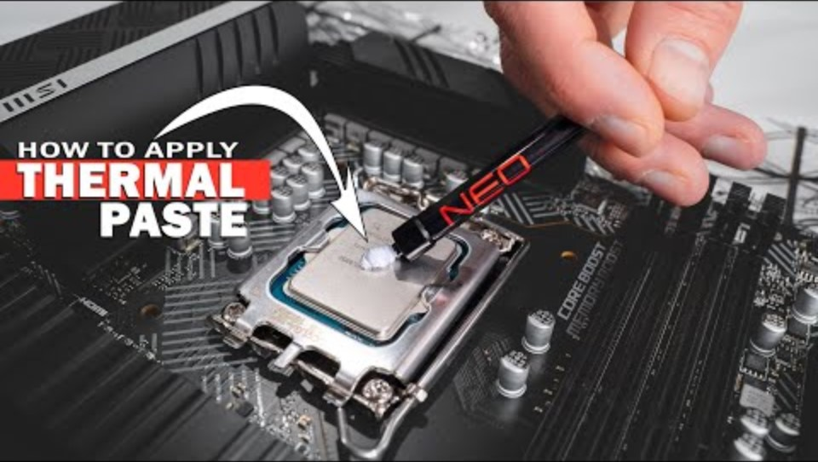

Slide 8
Different ways for applying thermal paste:
Pea size Method
Line Method
Cross Method
Spread Method
X Method
Dot & Spread Method
Pre Spread Method
https://youtu.be/arn2XSQvDVs?si=6ubZ4uBfX8iDZurz

Slide 9
Thank you!

